Slide 1
JS Obfuscation Detection
Moshe Lubliner
Dov Chriqui
Elana Bogdansky

Slide 2
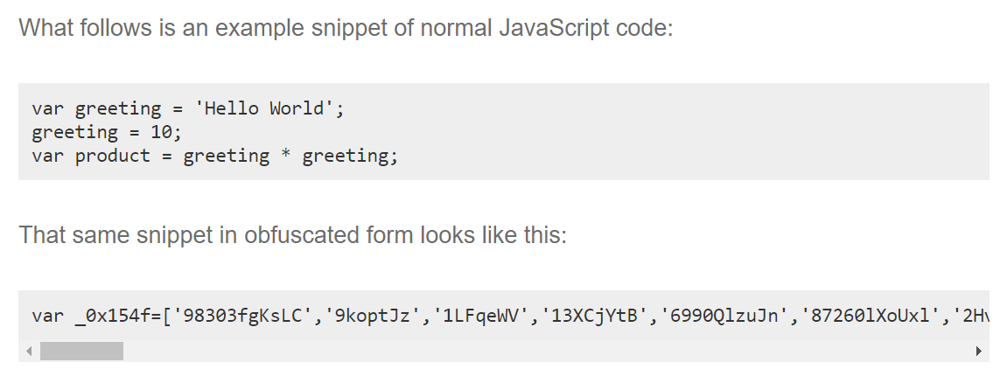
Background Info: JavaScript Obfuscation
JavaScript is used client-side on almost all websites, hence it is relevant to all businesses
Obfuscation is a technique for making JavaScript hard to read
Good intent obfuscation protects private information
Protects against cyber-threats and data breaches, keeps privacy on internal server name, usernames, etc.
Malicious intent obfuscation embeds malware or viruses within JavaScript
Spreads them from website to website or steals information
Many different obfuscation methods and the output of each looks different
Renaming variables/methods
Code transposition (reordering)
Dummy code insertion
https://www.techtarget.com/searchsecurity/definition/obfuscation
Notes:
moshe

Slide 3
Business Question
Is the JavaScript Obfuscated? (Yes/No)
If yes, this can be a signal of malicious activity which exposes our business to cybersecurity threats and potential $$ losses
AND our prediction model needs to be obfuscation method agnostic - be able to detect obfuscation regardless of what current (or yet to be invented) methods were used
Goal: Reach 99%+ accuracy
Notes:
yes/No - The score Imperva ranks is based on other stuff and therefore there is no error margin here
Important to have a high accuracy but important to have an efficient model. The simpler the model is the better it is

Slide 4
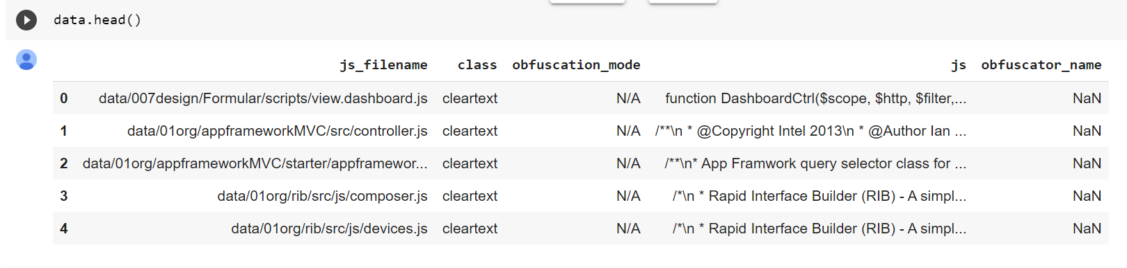
The Dataset
Source: Imperva cybersecurity firm YData project (https://ydataprojects.com/2022/#trigger-171 )
189,395 records
5 columns
js_filename
class
obfuscation_mode
js
obfuscator_name
4 obfuscation methods
Notes:
Elana

Slide 5
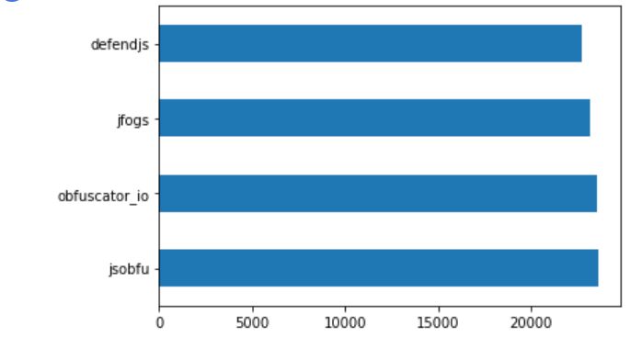
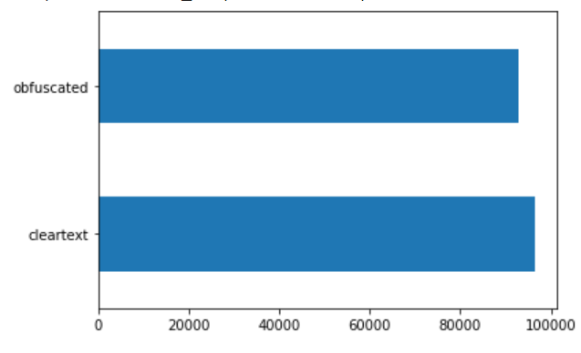
Summary Statistics
51% Obfuscated, 49% Clean
Even distribution of 4 obfuscation methods
Cleaning Data and Adding Features.ipynb
Notes:
Elana

Slide 6
Data Cleaning
Dropped unnecessary columns
Removed NaN
Removed comments from javascript
Removed the JS records which have empty or irrelevant JS (such as ‘alert(/xss/);’)
Reindexed the data
The Result: 187,560 records, 3 columns
Cleaning Data and Adding Features.ipynb
Notes:
Elana

Slide 7
Features
We created several features based on the JS codes
'js_length' - Length in characters of each JS code.
num_spaces' - Number of spaces
'num_parenthesis' - Number of parenthesis in the code
'num_slash' - Number of slashes
'num_plus' - Number of ‘+’ sign
'num_point' - Number of decimal signs
'num_comma' - Number of commas
'num_semicolon' - Number of semicolons
In addition, we calculated the ratio of these characteristics to the length of the JavaScript codes.
Split to Train_set 150,040 records and Test_set 37,510 records.
All our models used the same train and test data, for comparability
Notes:
Elana
In developing the features we decided to try an approach which predicts obfuscation based only on the features and not on the javascript text itself

Slide 8
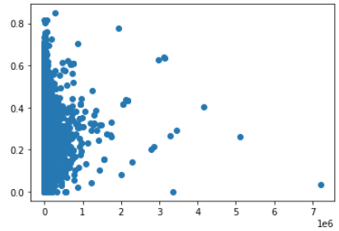
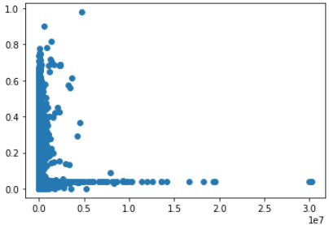
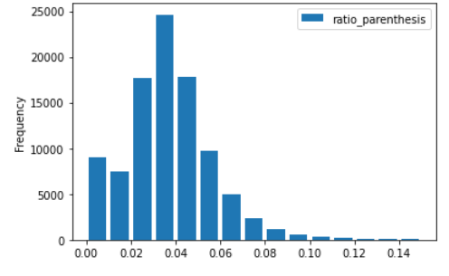
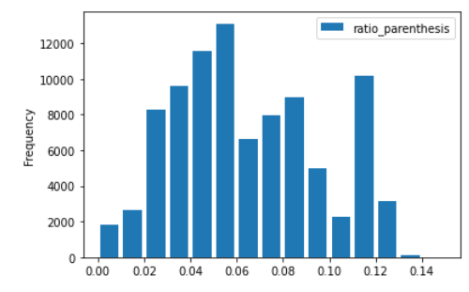
Exploratory Data Analysis
From the Data Exploration, we see some differences between obfuscated and non-obfuscated items
Clean
Obfuscated
Comments
Obfuscated JS has a lower proportion of spaces
num_spaces
ratio_spaces
js_length
js_length
Obfuscated JS tends to have a higher proportion of parentheses
Notes:
Elana

Slide 9
Method 1: Preprocessing with Doc2Vec
Notes:
moshe

Slide 10
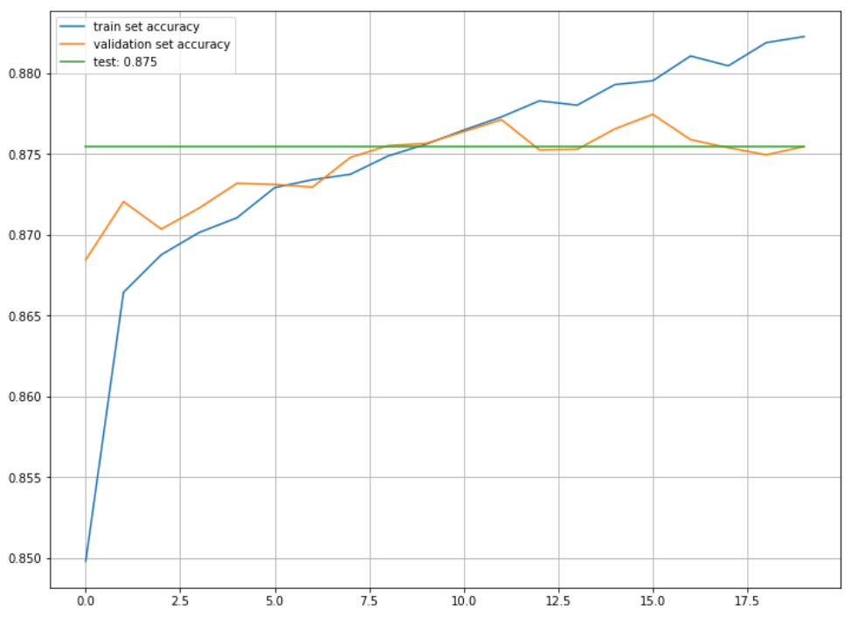
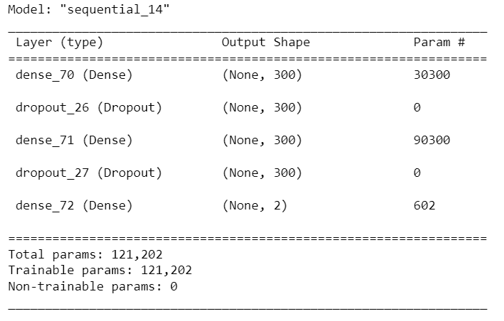
Preprocessing with Doc2Vec to create vector for neural network
Can Doc2Vec extract meaning from javascript even though it is not a natural language (and in some cases not even human readable)?
Use Doc2Vec to vectorize the javascript
Split “words” on /n
Capped “words” at 500
Vector size 100
Input the vector into a Neural Network
Adding complexity in layers did not increase accuracy, sometimes overfit
Went with simple model of 2 hidden layers with 300 neurons each and 10% dropout
87% accuracy on validation set
Notes:
Elana

Slide 11
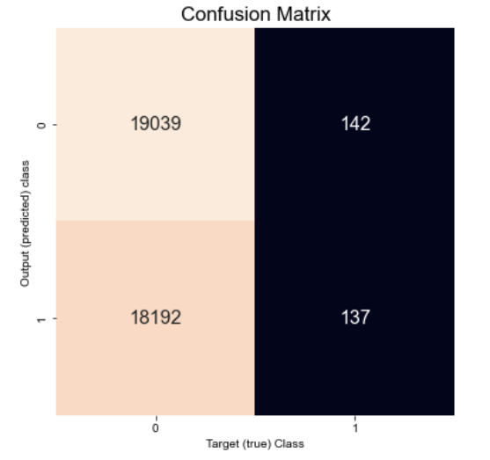
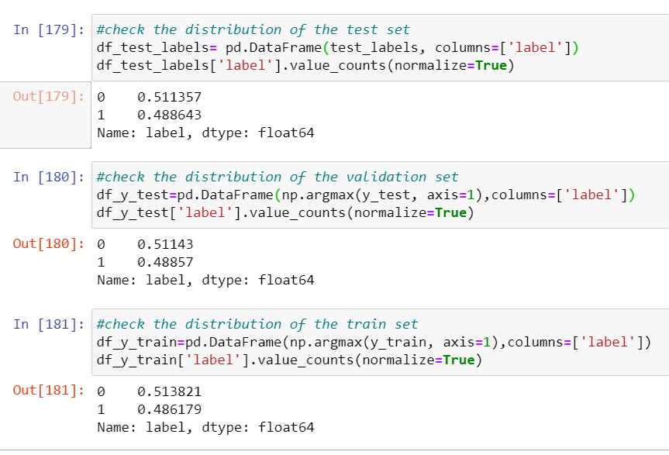
Doc2Vec- Predictions
However when we ran the model on the test set we achieved only 51% accuracy
Looking at the confusion matrix, the model tended to predict “0” or non obfuscated
We confirmed that the distribution of obfuscated/non-obfuscated was comparable in the training, validation, and test sets. We also confirmed that none of the sets was more heavily weighted to a particular obfuscation method.
Conclusion: Doc2Vec does not do a reliable job predicting obfuscation
Notes:
Elana

Slide 12
Method 2: Preprocessing with LDA
Notes:
moshe

Slide 13
Neural Network using LDA Representation
LDA as a method to translate the data into relevant numerical input for the NN
We tried to run the neural network with 3 different input options:
The numerical parameters (features) we created
The LDA representation of the corpus (15 topics)
Both of the previous options together
We run the model using an LSTM model, with 2 Hidden Layers, 50 units each, 20 then 25 % Dropout and Batch Normalization
Notes:
Dov

Slide 14
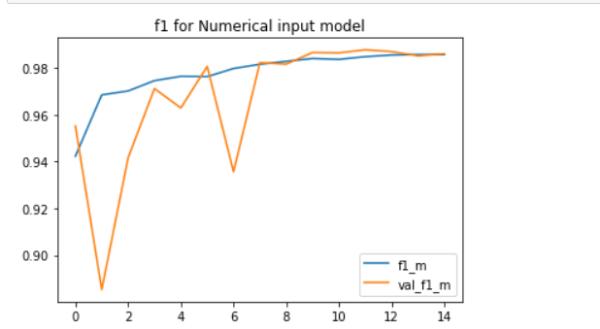
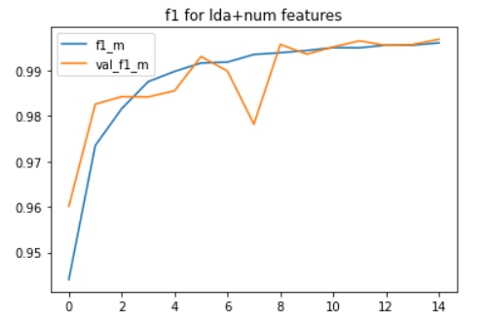
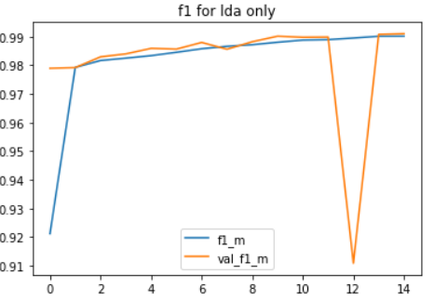
Neural Network using LDA Representation- Results
Training & validation data performances
Performance on test set:
Numerical input LDA+Numerical Input LDA representation
Notes:
Dov

Slide 15
Method 3: Random Forest
Notes:
moshe

Slide 16
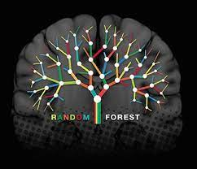
Random Forest
This model ignores the JS code itself and works only on its attributes
After several tries, we chose a forest of 1000 decision trees
A model with 100 trees takes a few minutes, but generates a smaller accuracy score
Our model with 1000 estimators took 13 minutes only to train for a very good accuracy
Notes:
Moshe

Slide 17
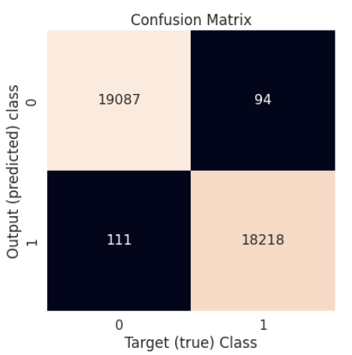
Random Forest- Predictions
The predictions are made on the train data, 80% of the raw data.
The tests are made on the test data, 20% of the raw data
Prediction score: 99.47%
Notes:
Moshe

Slide 18
Model Performance
Model | Accuracy (test set) | Precision | F1 | Training Time/Resources | Time (s) to predict
D2V→ NN | 87.8% validation 51.1% test | 85.5 validation 49.1% test | 87.6% validation 35% test | D2V 5 min 23s (32GB) NN 1 min 7s (8GB) | 6.13 s
LDA→ NN | 99% | 99% | 99% | 27 min (32GB) | 4 s
Random Forest | 99.475% | 99.45% | 99.45% | 7 + 13 min | 4.67 s

Slide 19
Conclusions
01
We can achieve very accurate predictions on text without “speaking the language”, include non-human readable text such as obfuscated JS (obfuscation detection by a person who is a trained expert can take 45 minutes)
02
Simple model can actually perform great, Random Forest shows equivalent result in less time.
03
Feature engineering here is key to our success, while sometimes input normalization hurts the models accuracy
Notes:
Dov

Slide 20
Opportunities for Future Work
01
Add more obfuscation methods, does it perform better on some than others?
02
More research on what we can accomplish using machine learning on coding languages
03
Train a wider model on the other 9 similar datasets that Imperva holds
04
Develop more complex features to enhance the Random Forest algorithms (e.g. repeated words)
05
Analyze which features are contributing the most to the Random Forest algorithm, remove those which are not
Notes:
Dov

Slide 21
References
01
Imperva and Yuriy Arbitman for providing the dataset and the challenge.
02
Aebersold, Simon, et al. "Detecting obfuscated javascripts using machine learning." ICIMP 2016 the Eleventh International Conference on Internet Monitoring and Protection, Valencia, Spain, 22-26 May 2016. Vol. 1. Curran Associates, 2016.
Notes:
Dov

Slide 22
Thank you for listening!

